Slide 1
Week 6 – Tuesday: Human-Computer Interaction
R. Jordan Crouser
Assistant Professor of Computer Science
Smith College
SCS Noonan Scholars – Summer 2018

Slide 2
Outline
Big idea
Why study HCI?
Some common (and less common) modes of interaction
Interpreting interaction
Open questions in HCI

Slide 3
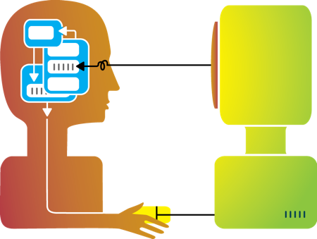
Recap: big idea behind my research
Humans and machines have complimentary strengths
Visualization
Perception
and
context
Interaction
Computational power
Image credit: Ali Ansari

Slide 4
This course so far
How does this part work,
and how to we get it to do what we want?
Computational power
Image credit: Ali Ansari

Slide 5
Today
How do we design ways for humans and machines to interact with one another?
Image credit: Ali Ansari

Slide 6
“Human-Computer Interaction” (def.)
“a discipline concerned with the design, evaluation and implementation of interactive computing systems for human use and with the study of major phenomena surrounding them.”
ACM SIGCHI Curricula for HCI (Hewett et al. 1992)
http://sigchi.org/cdg/cdg2.html

Slide 7

Discussion
Why do we care?
Notes:
How many different “computers” have you encountered since you got up this morning?
How many different “computers” have you encountered in your lifetime?
Have you ever encountered one that was poorly designed?
The way a system is designed effects not only how pleasant the experience is, but (possibly more important) things like productivity, accuracy, safety, etc.

Slide 8
Recap: Interaction (def.)
Ways for the user to affect change in what’s happening in the program
Low level: between human and interface
the set of operations available
happens between the human and the physical computer
High level: between human and problem space
a cognitive act enabled by the interface
happens between the human and the digital objects

Slide 9
Input devices
How many ways can you think of to get information from the human to the computer?

Slide 10




Mouse
Handheld pointing device
very common
easy to use
Two characteristics
planar movement
buttons used for making a selection, indicating an option, etc.

Slide 11
Touchpad
Small touch-sensitive surface
Used mainly in laptops
‘Acceleration’ is important
Fast stroke
lots of pixels per inch moved
initial movement to the target
Slow stroke
fewer pixels per inch moved
more accurate positioning

Slide 12
Touchscreen
Larger, touch-sensitive surface
Advantages:
fast, no specialised pointer
good for menu selection
easy to clean
Disadvantages:
finger can mark screen
imprecise
lifting arm can be tiring
Notes:
works by interrupting matrix of light beams, capacitance changes or ultrasonic reflections
direct pointing device

Slide 13
Keyboard
Most common text input device
Allows rapid entry of text by experienced users
Keypress closes connection, causing a char code to be sent
Usually connected by cable, but can be wireless

Slide 14
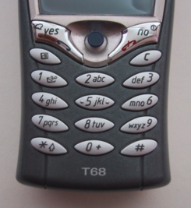
Keypad / T9
Standard: use numeric keys with multiple presses
hello = 4433555[pause]555666
surprisingly fast!
T9 predictive entry
type as if single key for each letter
use dictionary to ‘guess’ the right word
hello = 43556 …
but 26 -> menu ‘am’ or ‘an’

Slide 15
Handwriting recognition
Input text using a “pen” and a “tablet” (more natural?)
Technical problems:
capturing all useful information: stroke path, pressure, etc.
segmenting writing into letters
interpreting individual letters
coping with different styles of handwriting

Slide 16
Speech recognition
Improving rapidly
Most successful when:
single user
limited vocabulary systems
Problems with
external noise
imprecision of pronunciation
large vocabularies
different speakers

Slide 17
Lots of others!

Slide 18
Interaction as a reasoning aid
What kinds of (high level) things might someone want to get the computer to do?
Notes:
Interaction is situated in the context of a problem or goal-directed activity

Slide 19
Yi, Kang, Stasko and Jacko (2007)
Select: mark something as interesting
Explore: show me something else
Reconfigure: show me a different arrangement
Encode: show me a different representation
Abstract/Elaborate: show me more or less detail
Filter: show me something conditionally
Connect: show me related items
Yi, J. S., ah Kang, Y., Stasko, J. T., & Jacko, J. A. (2007). Toward a deeper understanding of the role of interaction in information visualization. Visualization and Computer Graphics, IEEE Transactions on, 13(6), 1224-1231.

Slide 20
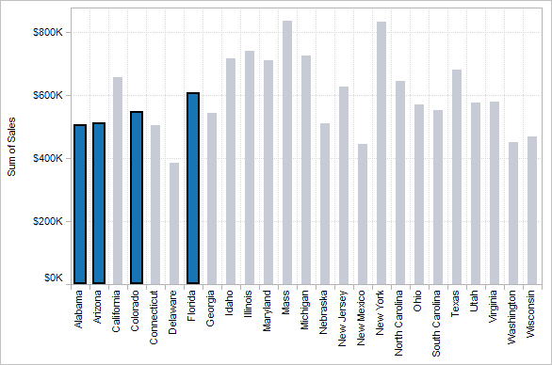
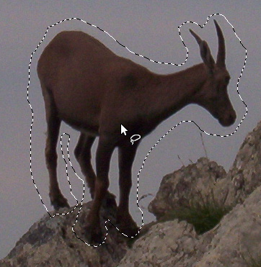

1. Select
“That’s interesting!”

Slide 21
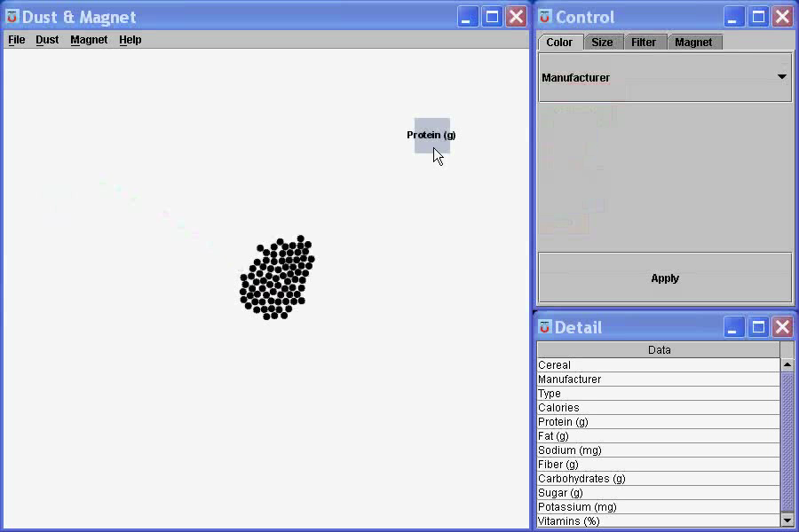
1. Select
“That’s interesting!”
Notes:
What are you selecting? One item at a time?
Selecting of a value?
Selecting of a range?
Selecting of a position on the screen?

Slide 22
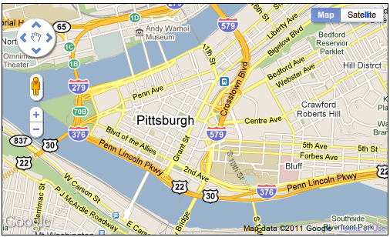
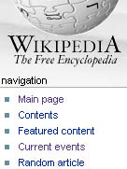
2. Explore
“Show me something else”
Scroll bars
Panning
Direct-Walk (e.g. hyperlink traversal)

Slide 23
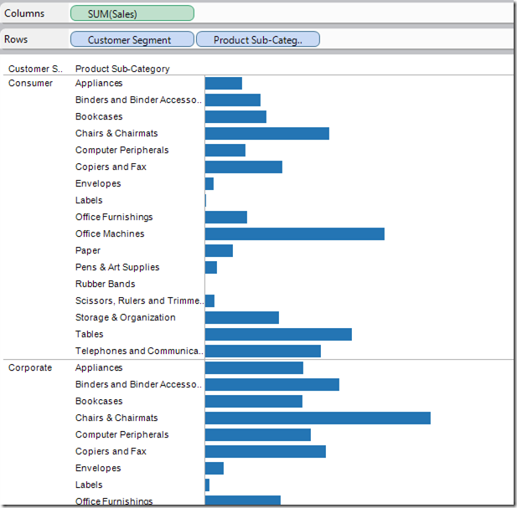
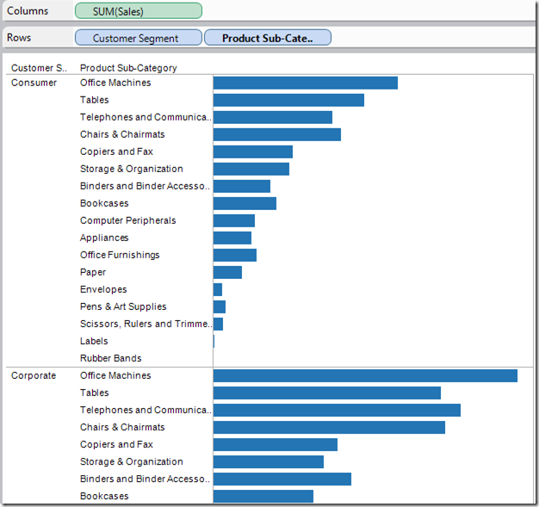
3. Reconfigure
“Show me a different arrangement”: sorting

Slide 24
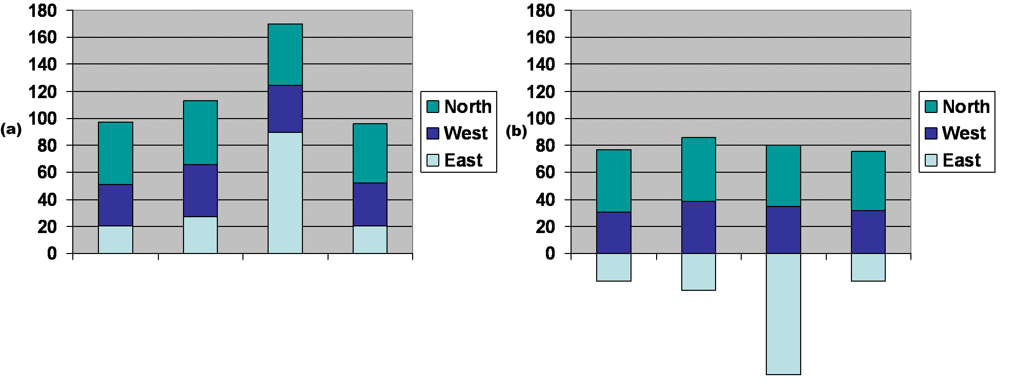
3. Reconfigure
“Show me a different arrangement”: baseline adjustment

Slide 25
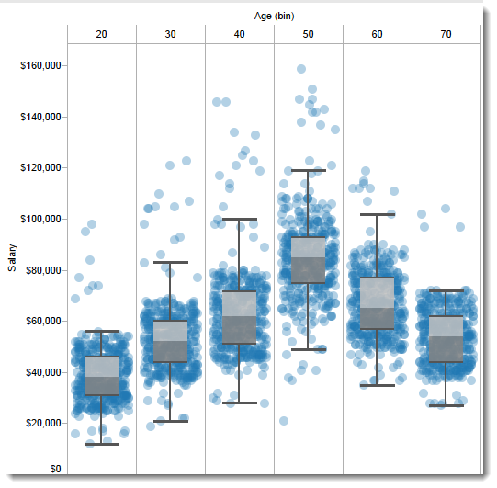
3. Reconfigure
“Show me a different arrangement”: reduce occlusion

Slide 26
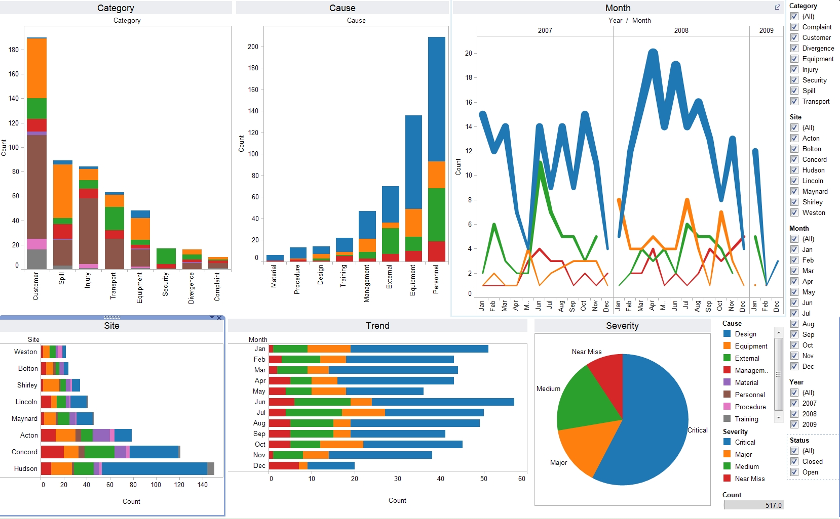
4. Encode
“Show me a different representation”: visualization type, color, size, orientation, etc.

Slide 27
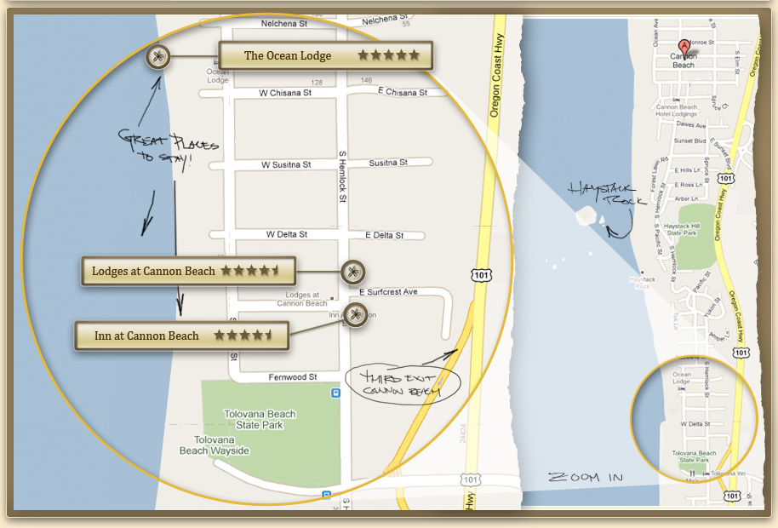
5. Abstract / Elaborate
“Show me more or less detail”: zooming

Slide 28
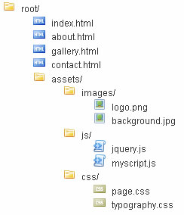
5. Abstract / Elaborate
“Show me more or less detail”: drill up/down

Slide 29
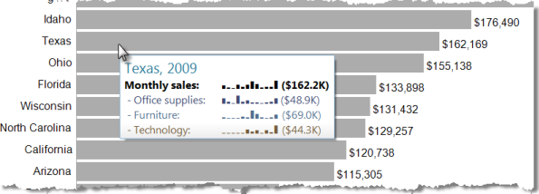
5. Abstract / Elaborate
“Show me more or less detail”: tooltips

Slide 30
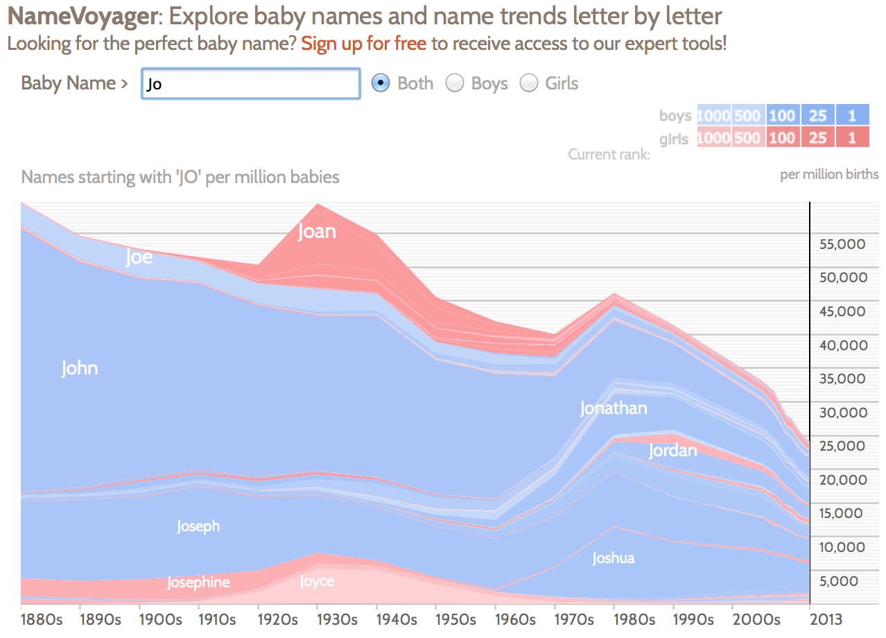
6. Filter
“Show me something conditionally”

Slide 31
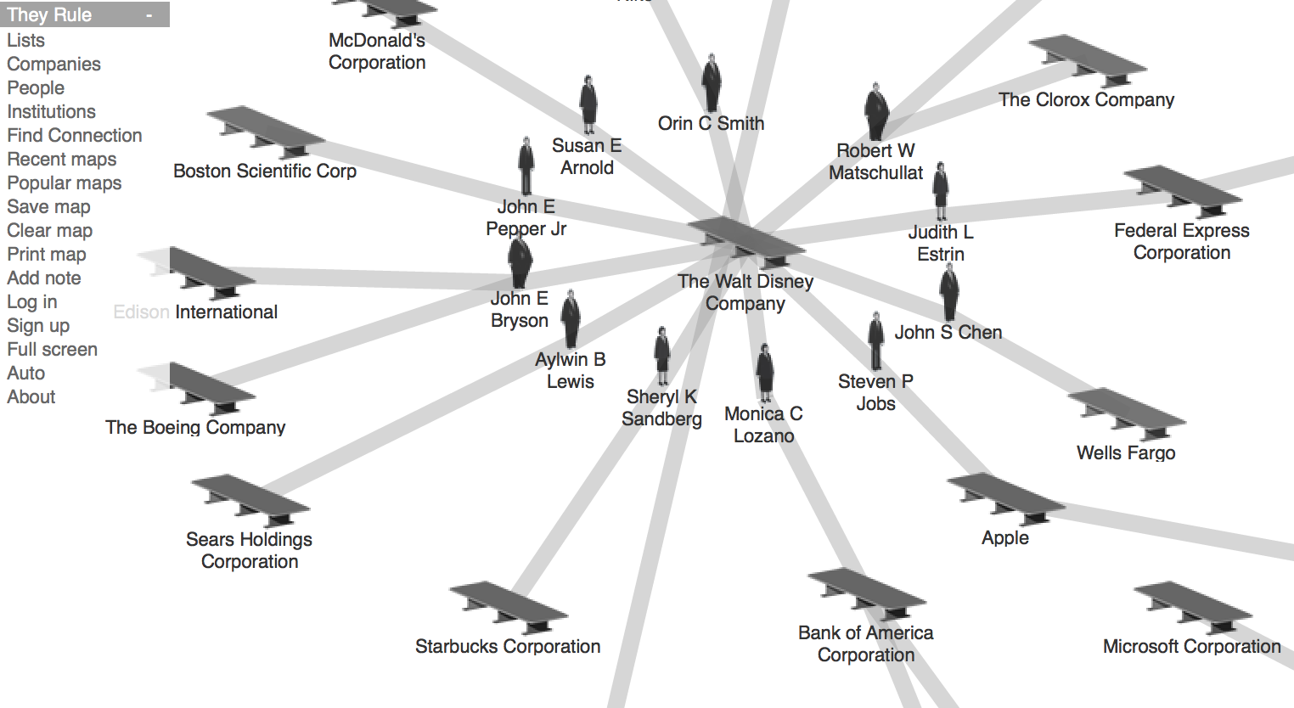
7. Connect
“Show me related items”

Slide 32
Discussion
What’s left to learn?

Slide 33
Some open questions in HCI
Do individual differences matter?

Slide 34
Some open questions in HCI
What about emotion?

Slide 35
Some open questions in HCI
What about scale?

Slide 36
Some open questions in HCI
Are kids just smaller grownups, or are they different?

Slide 37
Some open questions in HCI
What about older people?

Slide 38
Some open questions in HCI
What people with limited mobility?

Slide 39
Some open (ethical) questions in HCI
How does interacting through a computer influence decision-making?
How does it change human relationships?
Are we obligated to design only systems that improve human life, or should we explore other interactions? (i.e. ones that are cumbersome, difficult, scary,…)

Slide 40
Discussion
What do you think we should be asking?

Slide 41
This week
Monday: pygame
Tuesday: Human-Computer Interaction (HCI)
Wednesday: Making a Web Page
Thursday: Ethical Questions in CS (with Yoo Jeen)
Friday: Wrapping Up and Final Project Demonstrations

